Slide 1
Programming
Structures

Slide 2
Structures
A Structure is a collection of related data items, possibly of different types.
A structure type in C++ is called struct.
A struct is heterogeneous in that it can be composed of data of different types.
In contrast, array is homogeneous since it can contain only data of the same type.

Slide 3
Structures
Structures hold data that belong together.
Examples:
  Student record: student id, name, major, gender, start year, …
  Bank account: account number, name, currency, balance, …
  Address book: name, address, telephone number, …
In database applications, structures are called records.

Slide 4
Structures
Individual components of a struct type are called members (or fields).
Members can be of different types (simple, array or struct).
A struct is named as a whole while individual members are named using field identifiers.
Complex data structures can be formed by defining arrays of structs.

Slide 5
struct basics
Definition of a structure:
struct <struct-type>{
<type> <identifier_list>;
<type> <identifier_list>;
...
} ;
Example:
struct Date {
int day;
int month;
int year;
} ;
Each identifier
defines a member
of the structure.
The “Date” structure
has 3 members,
day, month & year.

Slide 6
struct examples
Example:
struct StudentInfo{
int Id;
int age;
char Gender;
double CGA;
};
Example:
struct StudentGrade{
char Name[15];
char Course[9];
int Lab[5];
int Homework[3];
int Exam[2];
};
The “StudentInfo”
structure has 4 members
of different types.
The “StudentGrade”
structure has 5
members of
different array types.

Slide 7
struct examples
Example:
struct BankAccount{
char Name[15];
int AcountNo[10];
double balance;
Date Birthday;
};
Example:
struct StudentRecord{
char Name[15];
int Id;
char Dept[5];
char Gender;
};
The “BankAcount”
structure has simple,
array and structure
types as members.
The “StudentRecord”
structure has 4
members.

Slide 8
struct basics
Declaration of a variable of struct type:
<struct-type> <identifier_list>;
Example:
StudentRecord Student1, Student2;
Student1 and Student2 are variables of StudentRecord type.
Name
Id Gender
Dept
Name
Id Gender
Dept
Student1
Student2

Slide 9
Ex. 1: struct basics
The members of a struct type variable are accessed with the dot (.) operator:
<struct-variable>.<member_name>;
Example:
strcpy(Student1.Name, "Chan Tai Man");
Student1.Id = 12345;
strcpy(Student1.Dept, "COMP");
Student1.gender = 'M';
cout << "The student is ";
switch (Student1.gender){
case 'F': cout << "Ms. "; break;
case 'M': cout << "Mr. "; break;
}
cout << Student1.Name << endl;
Student1
Name
Id Gender
Dept
Chan Tai Man
12345 M
COMP

Slide 10
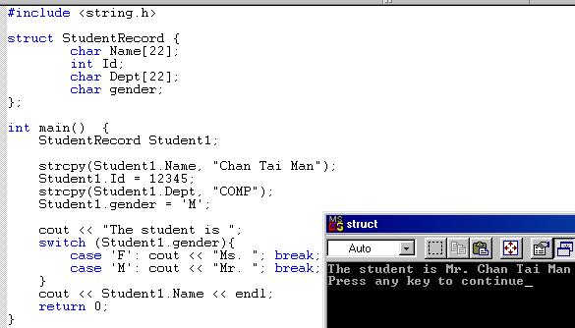

Slide 11
Ex. 2: struct-to-struct assignment
The values contained in one struct type variable can be assigned to another variable of the same struct type.
Example:
strcpy(Student1.Name,
"Chan Tai Man");
Student1.Id = 12345;
strcpy(Student1.Dept, "COMP");
Student1.gender = 'M';
Student2 = Student1;
Student1
Chan Tai Man
12345 M
COMP
Chan Tai Man
12345 M
COMP
Student2

Slide 12
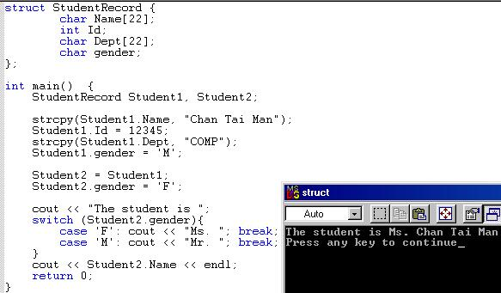

Slide 13
Ex. 3-5: Nested structures
We can nest structures inside structures.
Examples:
struct point{
double x, y;
};
point P;
struct line{
point p1, p2;
};
line L;
struct triangle{
point p1, p2, p3;
};
triangle T;
(P.x, P.y)
(L.p2.x, L.p2.y)
(L.p1.x, L.p1.y)
(T.p2.x, T.p2.y)
(T.p3.x, T.p3.y)
(T.p1.x, T.p1.y)

Slide 14
Ex. 3-5: Nested structures
We can nest structures inside structures.
struct line{
point p1, p2;
};
line L;
(L.p2.x, L.p2.y)
(L.p1.x, L.p1.y)
line
p1 p2
x y x y

Slide 15
Ex. 3-5: Nested structures
Assign values to the variables P, L, and T using the picture:
point P;
line L;
triangle T;
(4, 11)
(10, 9)
(2, 7)
(6, 5)
Ex. 3: Graph a point
Ex. 4: Graph a line
Ex. 5: Graph a triangle
(8, 3)
(2, 0)

Slide 16
Ex. 3-5: Nested structures
point P;
line L;
triangle T;
P.x = 4;
P.y = 11;
(4, 11)
(10, 9)
L.p1.x = 2;
L.p1.y = 7;
L.p2.x = 10;
L.p2.y = 9;
(2, 7)
(6, 5)
T.p1.x = 2;
T.p1.y = 0;
T.p2.x = 6;
T.p2.y = 5;
T.p3.x = 8;
T.p3.y = 3;
(8, 3)
(2, 0)

Slide 17
Arrays of structures
An ordinary array: One type of data
An array of structs: Multiple types of data in each array element.
0 1 2 … 98 99
0 1 2 … 98 99

Slide 18
Arrays of structures
We often use arrays of structures.
Example:
StudentRecord Class[100];
strcpy(Class[98].Name, "Chan Tai Man");
Class[98].Id = 12345;
strcpy(Class[98].Dept, "COMP");
Class[98].gender = 'M';
Class[0] = Class[98];
Chan Tai Man
12345 M
COMP
. . .
0 1 2 … 98 99

Slide 19
Arrays inside structures
We can use arrays inside structures.
Example:
struct square{
point vertex[4];
};
square Sq;
Assign values to Sq using the given square
(4, 3)
(10, 3)
(4, 1)
(10, 1)
x y
x y
x y
x y

Slide 20
Pointers

Slide 21

Pointer Data Type and Pointer Variables
Pointer variable: content is a memory address
No name associated with the pointer data type in C++
Syntax:
Examples:
  int *p;
  char *ch;
C++ Programming: From Problem Analysis to Program Design, Sixth Edition

Slide 22
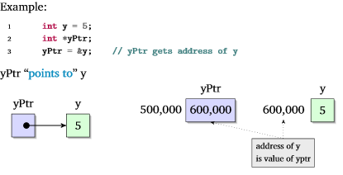
Address of Operator (&)
Address of operator (&):
  A unary operator that returns the address of its operand
C++ Programming: From Problem Analysis to Program Design, Sixth Edition

Slide 23
Program
// This program demonstrates the use of the indirection
// operator.
#include <iostream.h>
void main(void)
{
int x = 25;
int *ptr;
ptr = &x; // Store the address of x in ptr
cout << "Here is the value in x, printed twice:\n";
cout << x << " " << *ptr << endl;
*ptr = 100;
cout << "Once again, here is the value in x:\n";
cout << x << " " << *ptr << endl;
}

Slide 24
Program
#include <iostream>
void main(void)
{
int x = 25, y = 50, z = 75;
int *ptr;
cout << "Here are the values of x, y, and z:\n";
cout << x << " " << y << " " << z << endl;
ptr = &x; // Store the address of x in ptr
*ptr *= 2; // Multiply value in x by 2
ptr = &y; // Store the address of y in ptr
*ptr *= 2; // Multiply value in y by 2
ptr = &z; // Store the address of z in ptr
*ptr *= 2; // Multiply value in z by 2
cout << "Once again, here are the values of x, y, and z:\n";
cout << x << " " << y << " " << z << endl;
}

Slide 25
Function Call By Reference
When we pass address(es) to a function as arguments.
At the other hand there should be pointers to receive them.

Slide 26
Traditional Pointer Usage
void IndirectSwap(char *Ptr1, char *Ptr2){
  char temp = *Ptr1;
  *Ptr1 = *Ptr2;
  *Ptr2 = temp;
}
int main() {
  char a = 'y';
  char b = 'n';
  IndirectSwap(&a, &b);
  cout << a << b << endl;
  return 0;
}

Slide 27
Global V/S Local Variables

Slide 28
Global Variables
Declare outside the body of a function.
Life: They are alive through out the program execution.
Visibility: Can be used in the line of codes written after their declaration.

Slide 29
Local Variables
Declare inside the body of a function.
Life: They are alive till the execution of the function in which they are declare.
Visibility: Can be used in the line of codes present inside the function in which they are declared.

Slide 30
Example
int a, b, c;
void sum()
{
int x, y, z;
}
void main(void)
{
}

Slide 31
Thank You

